Slide 1

Browsers -Getting started
JS

Slide 2

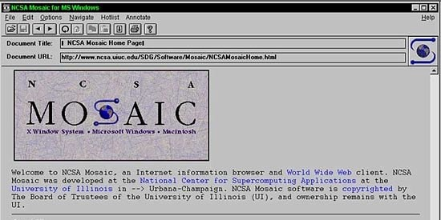
First Web Browser
Andreessen and colleagues leave NCSA to form "Mosaic Communications Corp" (Netscape).

Slide 3
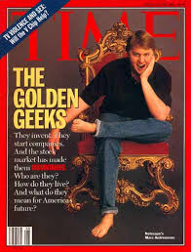
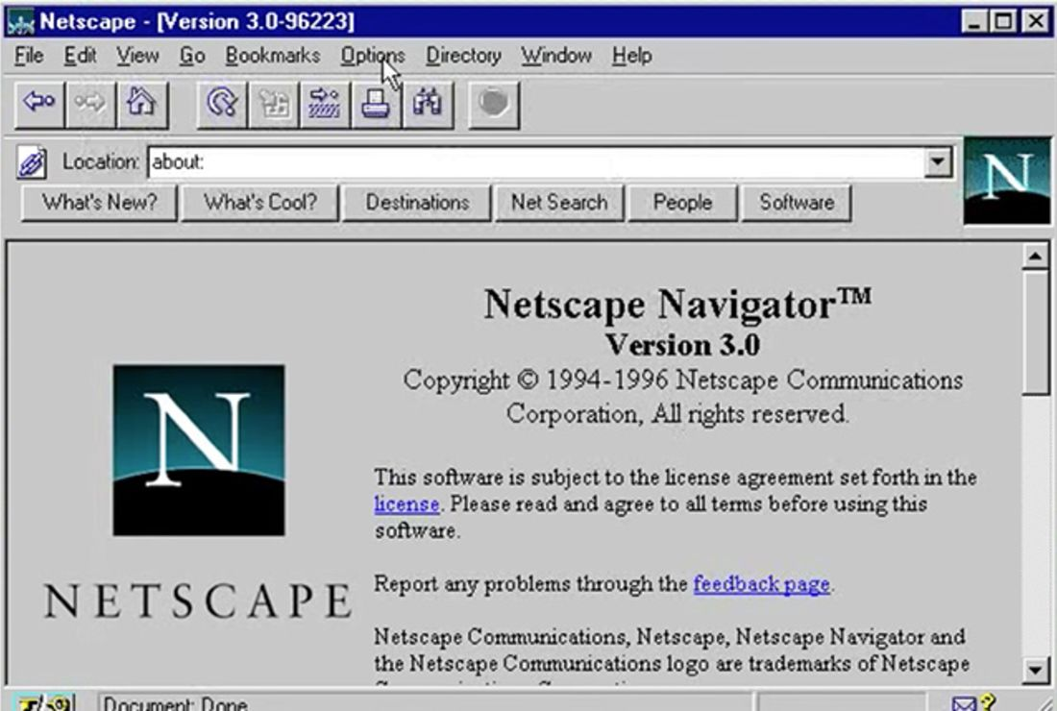
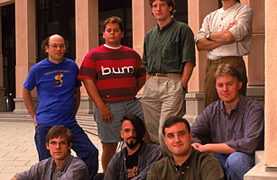
http://www.internethistorypodcast.com/2014/04/on-the-20th-anniversary-an-oral-history-of-netscapes-founding/

Slide 4
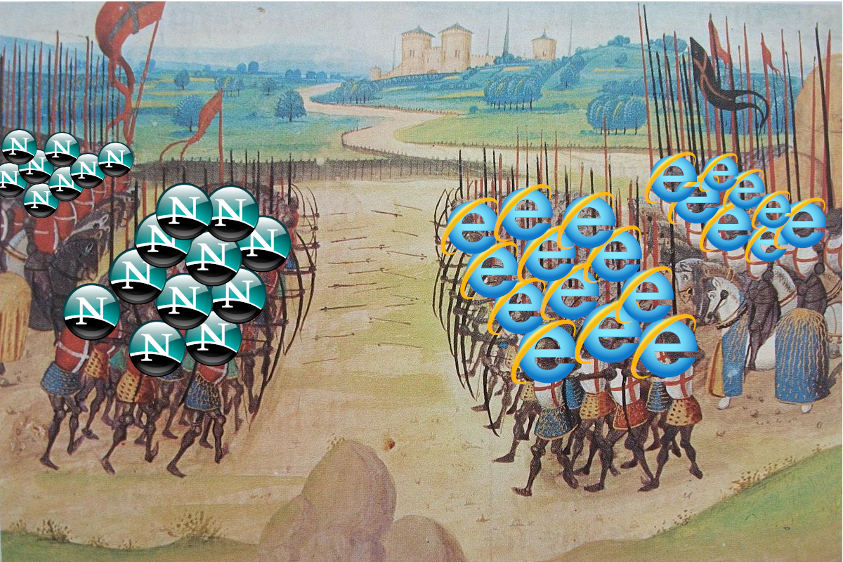
Browser Wars https://www.youtube.com/watch?v=VANORrzKX50
Src: https://medium.com/@traciemasek/a-brief-history-of-the-original-browsers-and-the-first-browser-war-7823fdf756fe

Slide 5
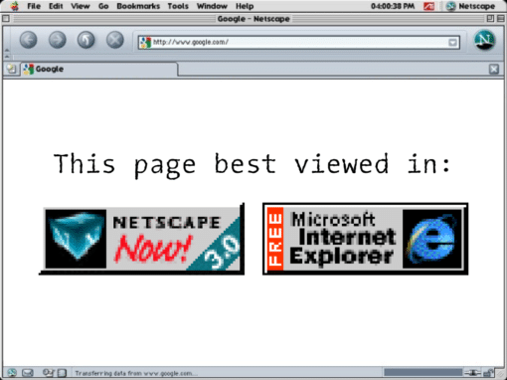

Slide 6
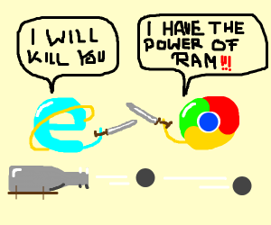
Browser War II

Slide 7

What is JavaScript?
Created by Netscape - 1995
Originally called LiveWire then LiveScript
Developed by Brandon Eich
Named to make use of Java market buzz
IE and Netscape renderings are slightly different
JScript created by Microsoft vs JavaScript
Standardized today as ECMAScript

Slide 8
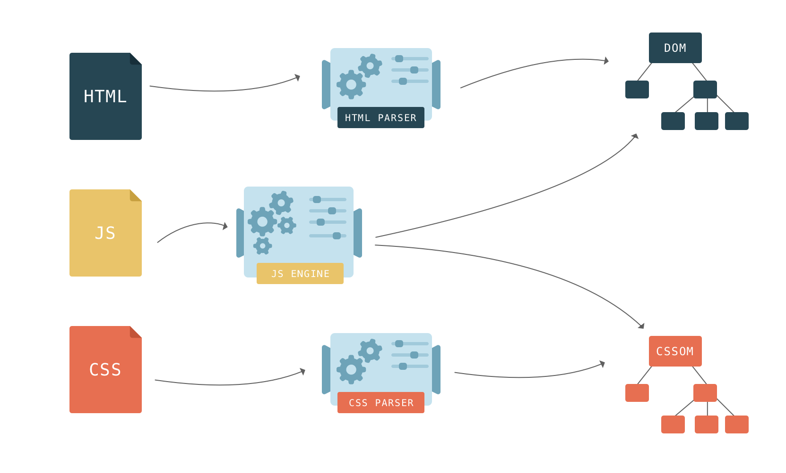

Slide 9
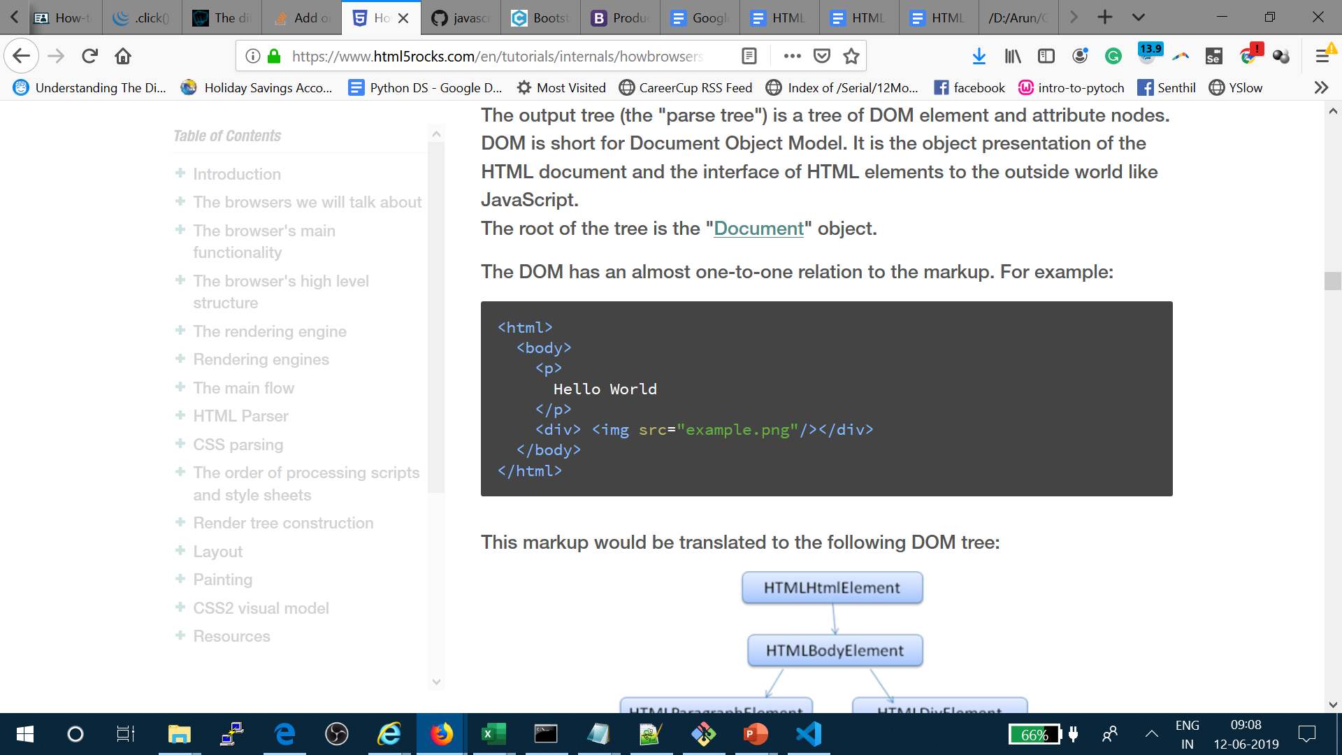
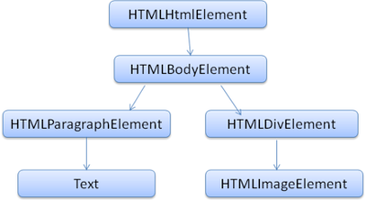
We will only allow at most 20 nested tags

Slide 10
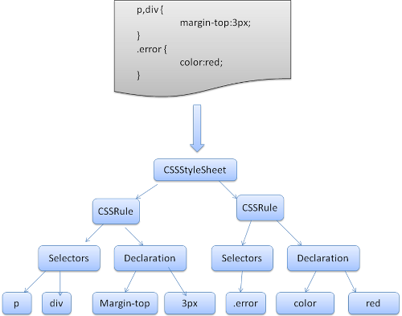

Slide 11

Structure of a Web Browser
User Interface
Browser Engine
Data Storage
Rendering Engine
Networking
JS engine
UI Backend

Slide 12
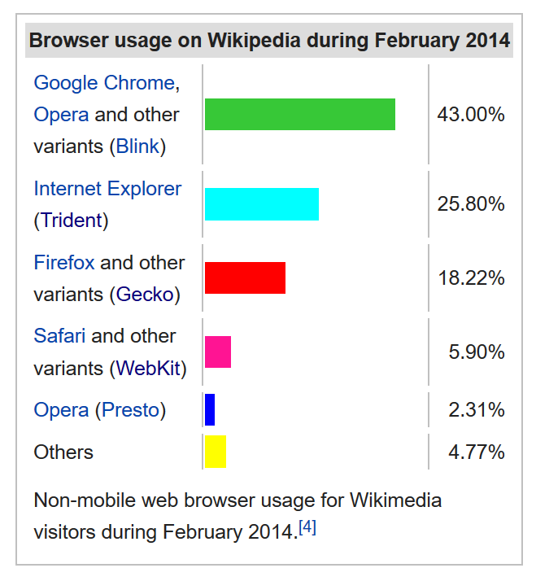
Layout engine or rendering engine

Slide 13
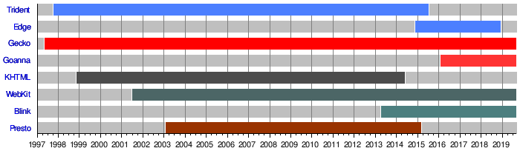
Layout engine or rendering engine

Slide 14



Rendering Engine
JS Engine
Blink
V8
Gecko
SpiderMonkey
Trident – IE
EdgeHTML - Edge
Chakra
Webkit
Nitro

Slide 15
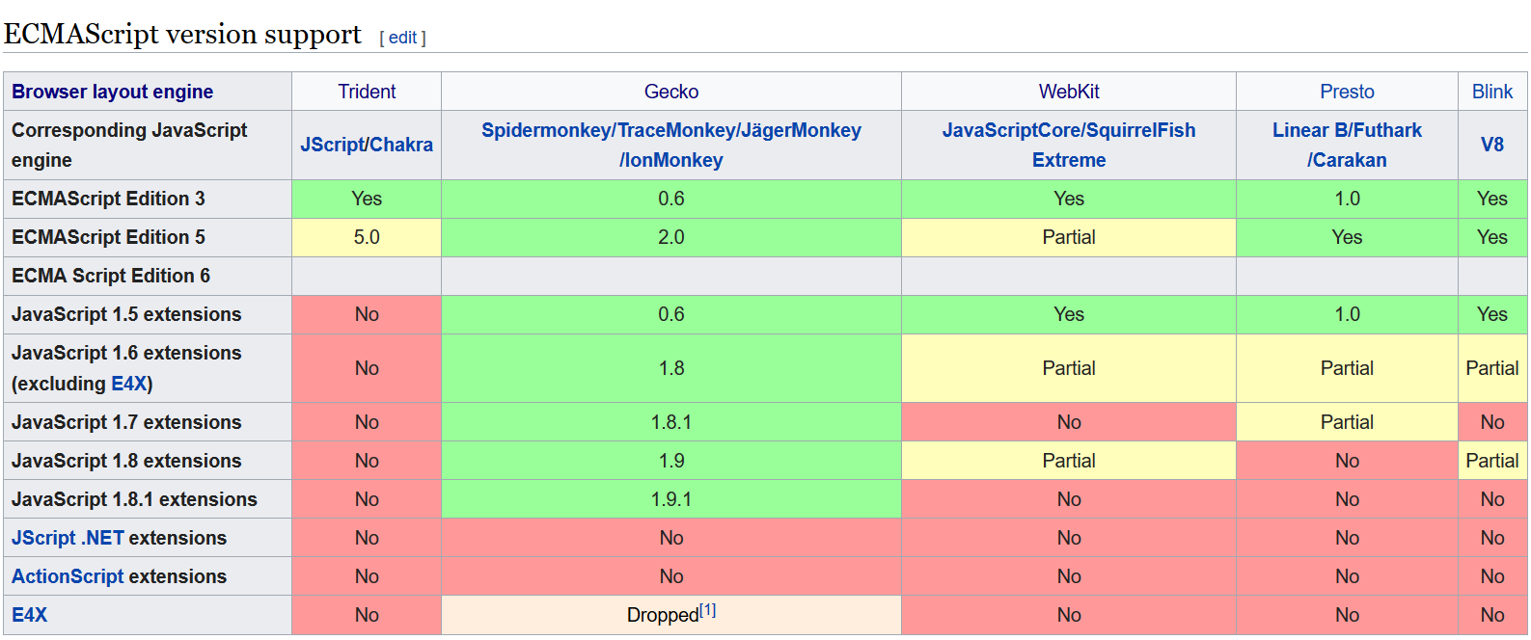
JavaScript engine or ECMAScript engines

Slide 16
Java
Scheme
Self
JavaScript

Slide 17
Google Chrome
Blink
Fork of WebKit
C++
Developed in-house by Google as part of The Chromium Project, a project “to open-source the code for the Google Chrome browser”
https://docs.google.com/document/d/1aitSOucL0VHZa9Z2vbRJSyAIsAz24kX8LFByQ5xQnUg/edit
V8 - Developed in-house by Google as part of The Chromium Project - Used in Node.js!
Mozilla Firefox
Gecko - Developed in-house by Mozilla - Written in Rust!
SpiderMonkey - The first JavaScript engine in history. Developed by Brendan Eich, the creator of JavaScript, while he was at Netscape.

Slide 18
Safari
WebKit - Created by Apple as a fork of the KHTML and KJS engines from Konqueror, a web browser developed by KDE.
Nitro (formerly SquirrelFish)
Edge
EdgeHTML - A fork of Internet Explorer’s Trident that was made not-shitty.
Chakra - Open-sourced as ChakraCore. - In 2016, Microsoft created a PR in the Node.js GitHub repo to use ChakraCore instead of V8. This PR was expanded out into its own project and now lives here as a project of the node organization.

Slide 19
Opera
Blink
- Fork of WebKit. Part of Chrome
V8
If something works on Google Chrome, you can expect it to work on Opera due to the identical rendering engine + JavaScript engine used.
Internet Explorer
Trident
Chakra

Slide 20
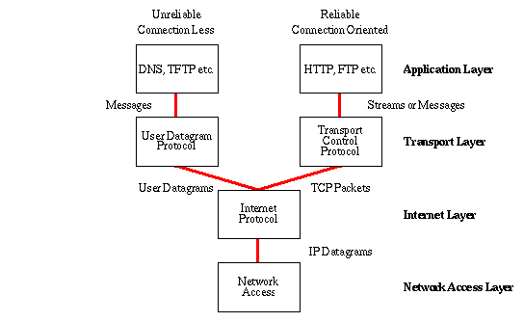
Common Internet protocols
TCP/IP
HTTP / HTTPS
FTP

Slide 21
IP – MAC address – Ports ➔ Discussion
Why IP address when we have MAC address
Why they are called as ports ? Why we need ports?
IMEA – MAC
IP – Mobile Number
Port – USB / C-type

Slide 22
HTTP
Hypertext Transport Protocol
Language of the Web
protocol used for communication between web browsers and web servers
TCP port 80 (443 secure)
RFC 2616 (ver 1.1)

Slide 23
Evolution of HTTP
HTTP/0.9 – The one-line protocol
GET /mypage.html
HTTP/1.0 – Building extensibility
HTTP headers
HTTP/1.1 – The standardized protocol
More than 15 years of extensions
HTTP/2 – A protocol for greater performance
HTTP/3 - HTTP over QUIC

Slide 24
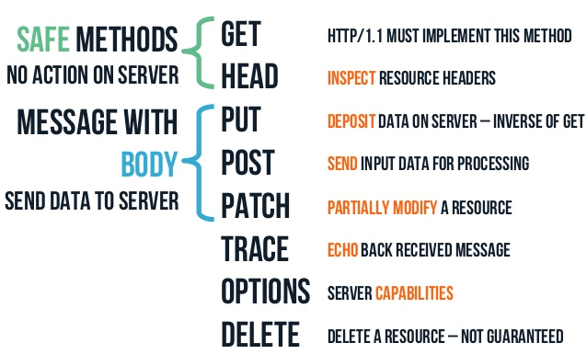
HTTP methods

Slide 25
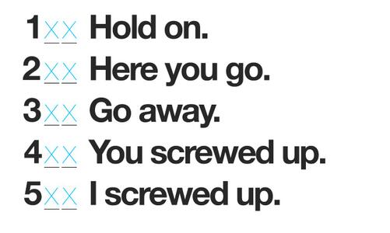
HTTP Headers

Slide 26


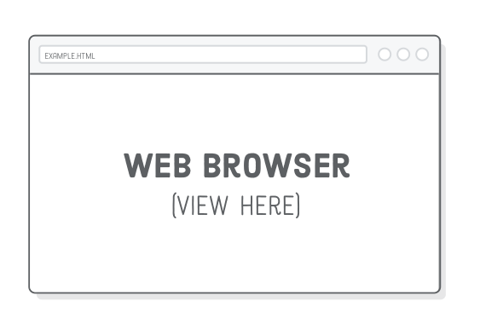


How the Server looks at the URL
Get /index.html
http://www.guvi.io:80/index.html
HTTP request
http://www.guvi.io
HTTP response
(content)
Default browser method is GET

Slide 27
CURL
https://curl.haxx.se/download.html
Veiw src → www.example.com
curl -i example.com
HTTP/1.1 200 OK
Age: 257088
Cache-Control: max-age=604800
Content-Type: text/html; charset=UTF-8
Date: Sun, 26 Jan 2020 12:56:40 GMT
Etag: "3147526947+gzip+ident"
Expires: Sun, 02 Feb 2020 12:56:40 GMT
Last-Modified: Thu, 17 Oct 2019 07:18:26 GMT
Server: ECS (oxr/8313)
Vary: Accept-Encoding
X-Cache: HIT
Content-Length: 1256

Slide 28
Tasks
Difference between HTTP1.1 vs 2
https://linuxize.com/post/curl-command-examples/
Do all the commands in this page , Copy & submit the result in a txt file

Slide 29
Web Content
Web servers return content to clients
content: a sequence of bytes with an associated MIME (Multipurpose Internet Mail Extensions) type
Example MIME types
text/html HTML document
text/plain Unformatted text
application/postscript Postcript document
image/gif Binary image encoded in GIF format
image/jpeg Binary image encoded in JPEG
format

Slide 30
Thanks

